Slide 1

e-MIS
(electronic-Management Information System)
Automated process of Collecting, Analyzing, Organizing, and Disseminating Information

Slide 2
Current Scenario
Despite the software revolution, many organization (private or public) in Nepal still depends upon the manual way of interpretation and analysis of the raw data.
The transformation is not overnight
The ‘Intelligent Network’ of Sundhara is no exception.

Slide 3
IN Department Operations
Currently, IN Department of Sundhara manages the 5 services, viz. PCC, PCL, AFS, HCD, UAN, etc.
Raw text files hold all the particulars of these call records in a daily basis.

Slide 4
What’s Happening at Present at IN
Reports are generated manually.
The process is tedious, time-consuming and error-prone.
The system essentially requires some form of automated process.

Slide 5
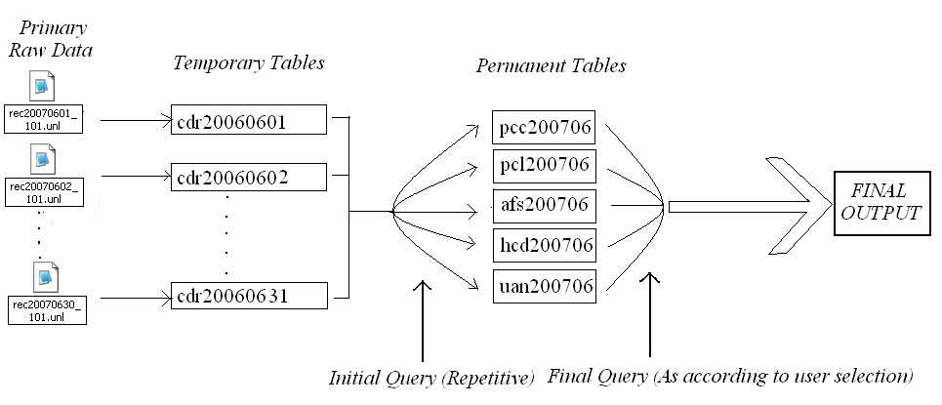
How eMIS Is Implemented?

Slide 6
What’s Inside eMIS
eMIS has two level of authentication i.e. admin and guest levels
The result of any Detail Report, Charge-class Report, Day-wise Report, Annual Report, Monthly Report can be shown in ‘Excel View’ (editable) and ‘Grid Form View’ (non-editable).
The ‘Excel View’ is only for admin level users while guest level users can use only ‘Grid Form View’.
Yet another level of security is added to enter the database.

Slide 7
Output Display Formats
  Annual View
  Month View
  Detail View (Normal View)
  Summary View
Charge-class-wise
Day-wise

Slide 8
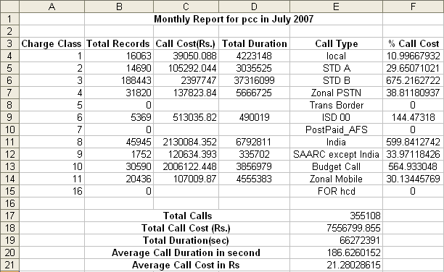
Monthly View

Slide 9
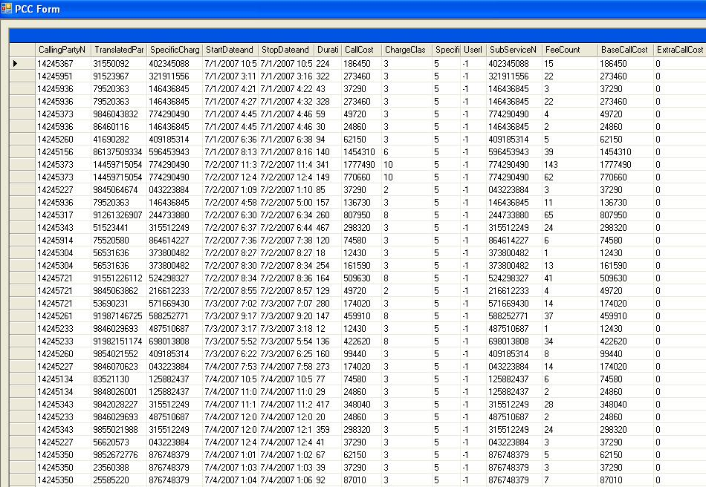
Normal View

Slide 10
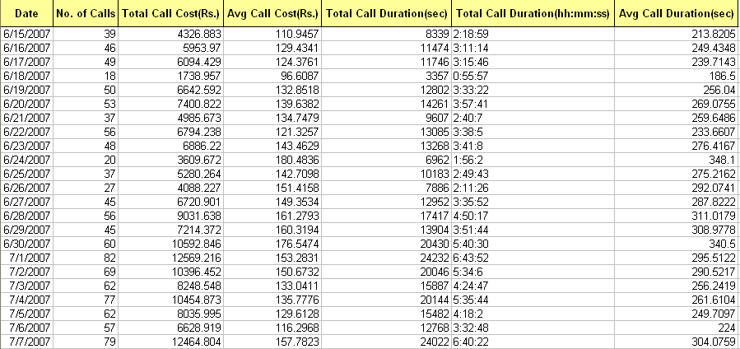
Day-wise View

Slide 11
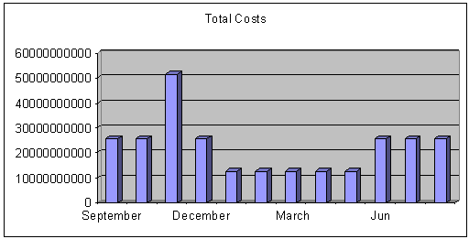
Annual View

